Slide 1
IBM FileNet Administration
Updated by
RaghuNandhan C

Slide 2

Introduction - ECM [FileNet Content Manager]
IBM Content Navigator
Content search services
Administration & Tools
Troubleshooting, Health Check, Logging & Trace
Workflow System
Course Content

Slide 3
Introduction ECM
[FileNet Content Manager]
IBM FileNet Administration

Slide 4
Enterprise Content Management
• Enterprise Content Management (ECM) is more than storing and managing documents.
• ECM is about:
Supporting business applications
Providing users with access to the right information in the context of their application.
Governing information and ensuring you meet business or industry regulations.
• ECM solutions enable businesses to support a wide-range of document-centric use cases.

Slide 5
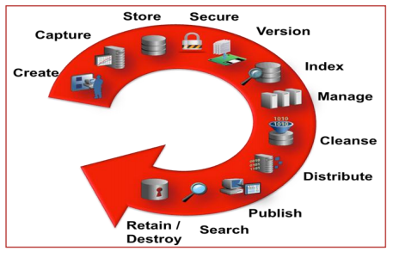
User Interface Records Management Metadata Management Logging/Reporting Security Event Management API & Programming Model Viewing & Publishing Workflow Web Content Management Email Management Search /Retrieval Document Transformation Capture Administration Indexing Digital Asset Management Migration Content Integration Storage / Repositories
ECM Capabilities

Slide 6
Content
For ex:-
Few of the ECM capabilities

Slide 7
FileNet Content Platform Engine
Content Platform Engine is a FileNet P8 component that is designed to handle the heavy demands of a large enterprise. It can manage enterprise-wide workflow objects, custom objects, and documents by offering powerful and easy-to-use administration tools. Using these tools, an administrator can create and manage the classes, properties, storage, and metadata that form the foundation of an enterprise content management (ECM) system.
Content Platform Engine content services
The Content Platform Engine content services are responsible for adding and deleting content and retrieving objects and content from an object store. In addition to servicing requests from enterprise content management (ECM) applications, the content services host various background tasks that maintain all the resources that are associated with each object store.
Content Platform Engine process services
The Content Platform Engine process services provide software services for managing all aspects of business processes (also called workflows), such as workflow execution, workflow routing, rules management, process simulation and modeling, and workflow analysis. You can use the workflow system components to create, modify, and manage workflows that are implemented by applications, enterprise users, or external users (such as partners and customers).

Slide 8
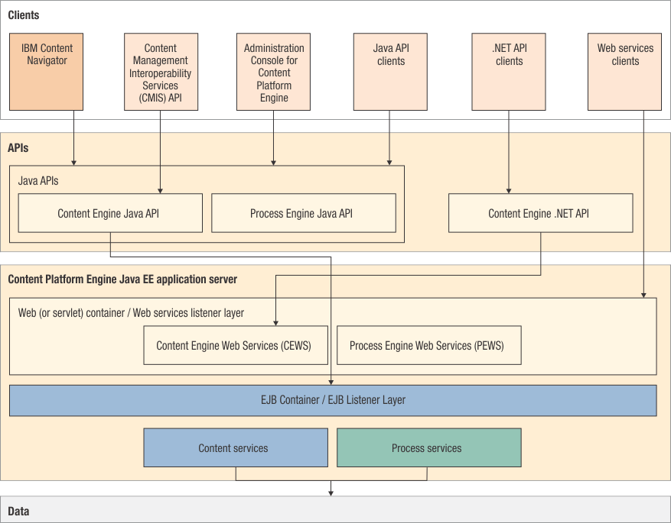
Content Platform Engine architecture
Content Platform Engine is a FileNet P8 Platform component that is designed to handle the heavy demands of a large enterprise. It can manage enterprise-wide workflow objects, custom objects, and documents by offering powerful and easy-to-use administration tools. Using these tools, an administrator can create and manage the classes, properties, storage, and metadata that form the foundation of an enterprise content management (ECM) system.

Slide 9
Key architectural aspects
• Application programming interfaces (APIs)
Provide an extensible platform for development and cross-object store queries, and lets administrators configure systems programmatically. A Java based API provides a rich set of Java classes that map to object store objects, such as Document, Folder, or Property Description; a Web Service API allows customers to author applications in a platform and language independent manner that expose the object model in a few generic methods suitable for deployment in a web environment; a Microsoft .NET framework-based API, functionally equivalent to the Java based API, provides for development of applications that use the .NET framework.
• Java EE-compliant application server
Java Platform, Enterprise Edition (Java EE) offers reliability, scalability, and high availability features, and support for a wide range of operating system platforms, application servers, and database technologies.
• Scalable
Can be deployed to suit the demands of the enterprise. As the enterprise's needs change, you can reconfigure the system by replacing, adding, or removing servers or applications without bringing the system down. You can add members to web server clusters and Content Platform Engine server clusters at any time.

Slide 10
Key architectural aspects [..continued]
• Content services
Responsible for adding and deleting content and retrieving objects and content from an object store. In addition to servicing requests from enterprise content management (ECM)applications, the content services host various background tasks that maintain all the resources that are associated with each object store.
• Process services
Provide software services for managing all aspects of business processes (also called workflows), such as workflow execution, workflow routing, rules management, process simulation and modeling, and workflow analysis.

Slide 11
FileNet P8 Platform integration options
• IBM Data cap
• IBM Enterprise Records
• IBM Case Manager
• IBM Content Collector

Slide 12
FileNet P8 Platform integration options [..continued] IBM Data cap A data capture product that scans, classifies, recognizes, validates, verifies, and exports data and document images quickly, accurately and cost effectively. Data cap can be used to automate the capture of data into the FileNet Content Manager object stores. IBM Enterprise Records IBM Enterprise Records is a records management solution that provides content, process, federation, and connectivity to automate and simplify all records-based activities by supporting records in both electronic and physical form from their creation to their disposition. IBM Case Manager IBM Case Manager simplifies the job of designing and building a case management system and provides a graphical user interface for caseworker to easily manage cases. IBM Content Collector IBM Content Collector archives email and other digital content in a central repository.

Slide 13
Support Components [ App Server , Database Server and Directory Server]
• App Server
We need any one of the below listed application server to host the FileNet Content Engine web application. Based on the transaction / user volume we can scale the application server which intern scale up the FileNet Content Engine instances.
List of application servers FileNet Content Engine supports are:
1. IBM WebSphere Application Server 2. Oracle WebLogic Server 3. JBOSS [ till CPE 5.2.1]
• Database Server
We need any one of the below listed database server to host the FileNet databases [ GCD database , Object store database, ICN database, etc.]
List of database servers FileNet Content Engine supports are:
1. Oracle database 2. MS SQL Server 3. IBM DB2
• Directory Server
We need any one of the below listed directory server to host the FileNet users / groups
List of directory servers FileNet Content Engine supports are:
1. CA Directory 2. IBM Security Directory Server 3. Microsoft Active Directory Server 4. Novell eDirectory 5. Oracle Directory Server 6. Oracle Internet Directory 7. Tivoli Directory Server 8. WebSphere Application Server [ using VMM]

Slide 14
FileNet P8 Domain
The FileNet P8 domain represents a logical grouping of physical resources and the Content Platform Engine servers that provide access to those resources. Each resource and server belong to only one domain. A server can access any resource in the domain, but cannot access any resource that lies outside of the domain.
The FileNet P8 domain is associated with one or more Java Platform, Enterprise Edition (Java EE) security policy domains. The Java EE domain is used to authenticate users and establish their group memberships. The identity and group membership of the user determine which FileNet P8 domain objects the user can access.
Global configuration Database
The global configuration database contains definitions of the common set of attributes that control functional characteristics of the collection of resources and services for the FileNet® P8 domain it represents.
The global configuration database provides hierarchical object storage and contains bootstrap data and global configuration information for the FileNet P8 domain. The global configuration database defines domain resources such as object store databases, full-text index areas, fixed content storage areas, content cache areas and marking sets. The global configuration database can contain sensitive information.
Only specified users or groups, typically administrators, have read and write access to the data contained within the global configuration database.

Slide 15
The information that is stored in the global configuration database is essential to Content Platform Engine. When a Content Platform Engine server is started, the global configuration data is read, and the data is cached in memory. If the global configuration database becomes unavailable, the Content Platform Engine system can continue processing in a limited mode as long as the information is available in memory
When the global configuration database is not available, an already active Content Platform Engine server can continue processing requests by using in-memory data, if the requests do not require an update to the global configuration database. Operations that require an update to the global configuration database cannot be completed and an error (E_GCD_NOT_AVAILABLE) is written to the system log. In this limited mode, most administrative and configuration changes are prohibited. After the global configuration database becomes available again, the Content Platform Engine server will automatically reconnect and resume processing in a fully functional
A FileNet P8 domain has the following characteristics:
The servers in a FileNet P8 domain are platform-independent and can be in separate Java EE domains.
The database servers associated with the FileNet P8 domain can be in a different domain.
Content Platform Engine services are associated with the FileNet P8 domain in which the services were originally created and cannot provide services to other FileNet P8 domains.
The user names that are used to log on to a client application and to gain access to the FileNet P8 domain are provided by one of the supported application server authentication providers.

Slide 16
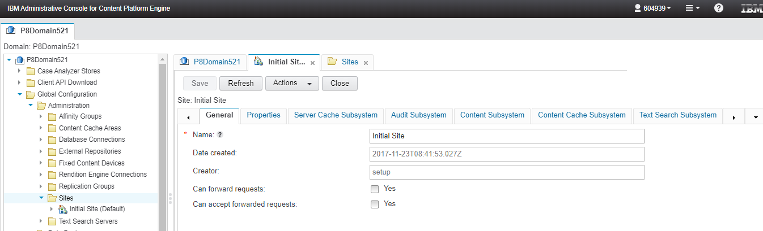
Site
A site represents a geographical location where resources are connected by using a fast, reliable local area network (LAN).
You can create a site at any time to organize resources based on network topology. Object stores, storage areas, content cache areas, index areas, and virtual servers are all associated with an individual site. There is no limit to the number of sites that a single FileNet P8 domain can contain. Each site name must be unique within the domain.
You can move a site component at any time to organize resources to match your network topology. After you create a domain, the domain node contains one site named Initial Site; this site is set as the default site for the domain. The default site contains the associated resources such virtual servers, index areas, and object stores. Resources that are added to the domain are associated with the default site, unless otherwise specified.

Slide 17
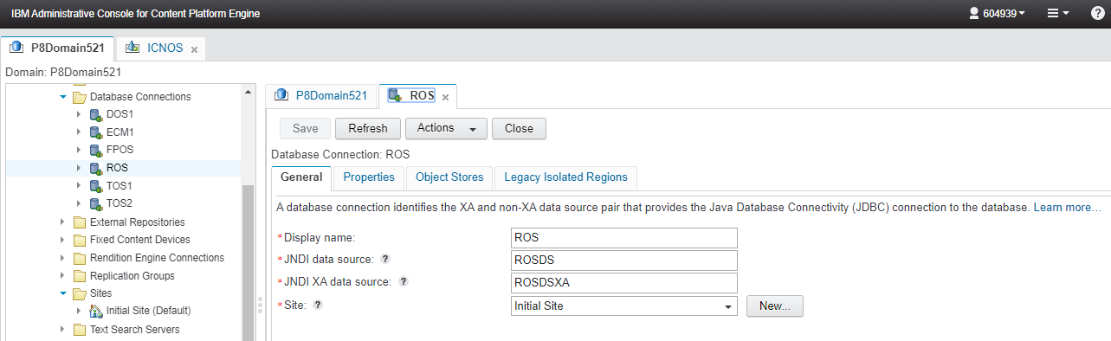
Database Connection
A database connection identifies the XA and non-XA data source pair that provides the Java Database Connectivity (JDBC) connection to the database. Object stores and isolated regions can share a database by using a single database connection.
A database connection is specific to a site. When you create an object store or an isolated region for the site, you associate it with a database connection. To share a database, you assign the same database connection to one or more object stores or isolated regions.

Slide 18
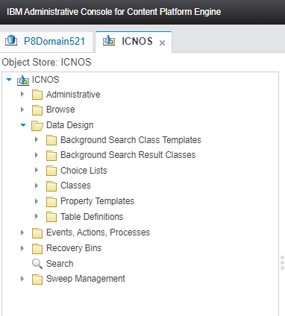
Object Store
A repository for storing objects
Object metadata is in a database.
Content can be stored in the database or it can be stored in storage areas:
File storage area
Fixed storage area
Advanced storage area
Content cache area
Folder structure in object store
Root Folder
Unfiled folder
Tasks that are done in an object store:
Configure security and storage policies.
Create objects to store data.
Configure events and processes.
Browse to the objects.
Search for documents and folders.
Manage Sweeps.
Configure Index.
An object store can have one database storage, and zero or more storage area.

Slide 19
Storage Area
A storage area is a place where Content Platform Engine stores content.
There are 4 different Storage area types available in FileNet Content Manager which are listed below.
Database storage areas
A database storage area is the database used for the object store. That is, Content Platform Engine stores both the objects and the content for those objects in the same database.
File Storage Areas
A file storage area is a hierarchy of folders on a shared network drive accessible by the Content Platform Engine server.
Fixed Storage Areas
A fixed storage area is a file storage area with an associated external (non-FileNet P8) fixed content system that provides more storage capacity and data retention.
Advanced storage areas
An advanced storage area supports heterogeneous storage devices. OpenStack cloud storage and file system storage can be used in an advanced storage area.

Slide 20
Security in IBM FileNet
Goals of security
Control access to information assets in the system.
Provide a framework for managing control of the assets.
IBM FileNet P8 security mode
Wide range of options for flexible security solutions
Domain architecture defines a security context
Limits access to domain resources.
Grants access only to users with sufficient permissions.
Specifies permissible actions on objects.

Slide 21
Authentication
Authentication
Who you are.
Identifies the user who is trying to log on.
Requires credentials (a user name and password).
Uses an authentication provider LDAP directory service
Creates a security token (a data structure that typically persists until the user logs out).
Uses JAAS and WS-Security standards.
FileNet P8 domain
Provides the security context for authenticating applications.
Is created during IBM FileNet P8 Platform installation.
Authentication - Authentication is the act of verifying a user identity based on credentials that the user presents. Authentication of individuals, or ideally of the roles that an individual has, through the external authentication mechanism, is key to the security features in IBM FileNet Content Manager. The two standards at the core of the authentication process in FileNet Content Manager are the Java Authentication and Authorization Service (JAAS) standard and the Web Services Security standard. The JAAS standard forms the framework for security interoperability in the Java EE world. The Web Services Security standard forms the framework for security interoperability in the heterogeneous world of clients and servers that communicate through web services interfaces.

Slide 22
Authentication provider - An authentication provider is a supported LDAP-compliant directory service that provides authentication for the FileNet P8 domain. The authentication provider is identified during FileNet P8 installation through the JAAS configuration.
Supported directory service providers include IBM Tivoli Directory Server, CA Directory, Novell eDirectory, Sun Java Directory Server, Oracle Directory Server, and Microsoft Active Directory.
Authorization
What you can do
Determines what the user can do (examples: view, delete, modify).
Requires earlier authentication.
Uses Security token that is generated during authentication.
It is object-based.
When an authenticated security principal attempts to access FileNet P8 objects, Content Platform Engine attempts to retrieve that principal's user and group memberships from the directory service provider. If successful, the user is authorized to complete actions on the object.

Slide 23
User roles Different user roles are responsible for securing different types of objects. For example, administrators, solution builders, authors, and users might have different access rights to the same objects.
Even administrators with access to Administration Console for Content Platform Engine can have different levels of access to objects. For example, one administrator might have permission to modify document classes, properties and templates that another administrator has no access to.
Independent and dependent security
Most objects have Access control Lists (ACLs) that can be independently set. These objects are called independently securable.
Dependently securable objects depend on their parent object for their access rights. They are secured through the parent object.
Examples of dependently securable objects follow:
Content elements, which have the same security as the associated document object.
A property that is assigned to a securable object, which has the same security as that object.
The individual choices in a choice list, which have the same security as the object that the choice list is assigned to
A lifecycle state in a lifecycle policy.
Security is more than securing documents and folders. The security of the system design determines which objects are securable by which users. For example, administrators might be responsible for securing the domain root and the object stores. Application builders might be responsible for securing classes, instances like stored searches and entry templates, and property templates. Authors might be responsible for securing folders and documents.

Slide 24
Security principals
Generic name for users and groups
Are identified by a security identifier (SID)
Stored internally in the Content Platform Engine.
SID does not change after assignment.
Are special logical security principals that are maintained by the Content Platform Engine
AUTHENTICATED-USERS (all domain users)
CREATOR-OWNER
Use naming conventions.

Slide 25
The different naming conventions play an important role when you are viewing and configuring security in different contexts. In most of the interfaces that are used for this unit, you see only a short name or a principal name. Security settings that are related to system configuration often use the distinguished name because it is important that the security principal be uniquely identifiable in the security context within which the system is designed to operate.
#AUTHENTICATED-USERS is a group that consists of all domain users.
#CREATOR-OWNER is a role that is assigned to anyone who creates an object. Normally, the #CREATOR-OWNER has ownership of the object by default, but this behavior can be changed for security reasons.
Security principals are also called grantees.
Users and groups:
The directory service defines the security principals.
Users are assigned to groups.
Use groups as primary security principals whenever possible.
Example for a Finance department

Slide 26
Security realms
•Realm
A collection of all user accounts and group memberships available to the FileNet P8 domain
Created, maintained, and authenticated by the authentication provider
Read and used by the FileNet P8 domain
•Multiple realms
The IBM FileNet P8 Platform supports multiple realms.
Multiple realms
You can create multiple authentication realms on your application server. For each authentication realm that you create, you must also create a corresponding directory configuration in Content Platform Engine so that the users and groups in the authentication realm can be authorized. Content Platform Engine requires that all directory services be accessible at run time. If one becomes inaccessible, Content Platform Engine cannot run, even though other directory services are still running. Configure LDAP failover for each directory service to avoid this problem.

Slide 27
Permissions
• Objects are secured by a set of permissions that control all operations on that type of object.
• Permission
The right to perform a specific operation on a securable object.
For example, the right to delete an object.
Also called an access right.
• Permission group
A predefined set of access rights.
For example, Full Control.
Also called an access level.
• Access control entry (ACE)
A set of access rights for an object that is associated with a single security principal (grantee)
• Access control list (ACL)
The set of ACEs associated with an independently securable object

Slide 28
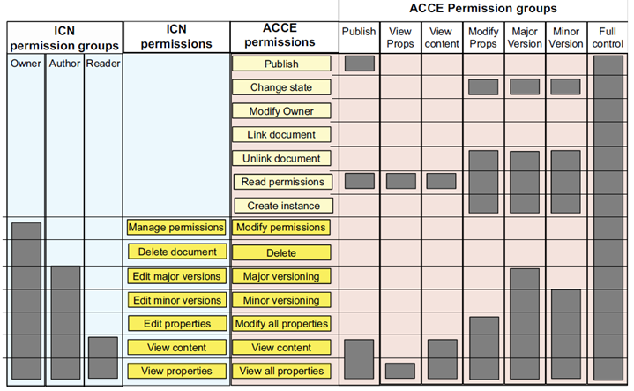
Permission groups
The graphic shows a graph of permissions for different
permission groups and compares the editable
permissions in IBM Content Navigator and ACCE.
Setting permissions on a document in IBM
Content Navigator (ICN) and in
Administration Console (ACCE) provide different
experiences and different levels of granularity.
Permissions that are granted in the
Administration Console include all of the permissions
that can be granted in Content Navigator, plus a few
more permissions. Highlighted permissions have
different names in each interface,
but are functionally equivalent.
IBM Content Navigator provides a simple interface to quickly edit the most commonly used permissions.
Use Administration Console for Content Platform Engine if you need to edit other permissions, such as the right to publish or change the state of a document

Slide 29
Access Control in Administration Console:
The graphic shows a typical document ACL in Administration Console for Content Platform Engine. The insert shows the individual permissions for one ACE.
In Administration Console for Content Platform Engine, the administrator can specify a permission group, such as Full Control or Major Versioning to select commonly used groups of permissions. You can customize the permissions of the ACE by selecting or clearing individual permissions. The resulting ACE is shown as having Custom permissions.
You can access the ACL for an object on the security tab for that object.

Slide 30
Security to Objects Normally, an object's security is controlled or determined in four ways. (Markings, if they are used, would be a fifth way) 1. Security parent and inheritance: Permissions can also be inherited from a parent object. Inheritance can take place between a class and its subclass, and between a folder and its containable objects (documents, custom objects, and other folders). 2. Direct Security: Users who have sufficient permission can edit an object's security by directly adding or removing security principals, or by changing the existing permissions already granted. 3. Default Instance Security : As an integral part of the class and instance design, objects such as documents, folders, and events are instances of their class. The class includes, among other things, a property containing the default security permissions that will be applied to all instances of the class. This is the simplest method of applying security: the security design sets up the default security that all instances of a class should have, and then all objects based on that class will have the same default security.

Slide 31
Security to Objects [..Continued] 4. Security Policy and security templates : Security policies contain security templates which let you automatically apply security to documents, folders, and custom objects. In the case of documents, security templates can be associated with one of the several versioning states that documents pass through (Released, Superseded, In Process, or Reservation). This powerful feature provides efficient application of fine-tuned security across many objects. 5. Marking Sets : FileNet Content Engine (CE) Markings or Marking Sets provides a way to define a level of security on objects (i.e. documents) in addition to the normal FileNet P8 object security model. By using markings, access to objects can be controlled based on specific property value. Marking set's are collection of CE objects known as marking objects. Marking sets allows setting up security on an object with means of property template. When a marking is applied to an object, the resulting access permissions for the object are a combination of the settings of its original access permissions (through ACL) and the settings of the markings 'Constraint Mask' for each marking that is applied to it. The result of this combination is the effective security mask.

Slide 32
Security sources
• Permissions for an object can come from various sources.
Sources can be used in combination.
Precedence is determined by order of evaluation.
Security is determined dynamically when the object is accessed.
This fact is significant for inherited security.

Slide 33
Security sources and order of evaluation Object
Each security permission can be set to Allow or Deny. If a principal has nothing that is allowed, access is denied. When nothing is allowed, it is implicitly denied. Most security scenarios can function perfectly with Allows only.
In a system that uses Allows only, security from multiple sources are summed. The order of evaluation is not important.
Example, if Fred is Allowed view properties from Direct security, and he also has Major Versioning from a template, then he has both capabilities.
The order of evaluation is important to understand only if you use Denial.
This order determines how security issues are resolved. If someone is allowed access by one security source and denied by another security source, the security is determined by which source comes first in the order of evaluation. For example, if a security policy template allows access and folder inheritance denies access, the user is allowed to view the object because the template security is evaluated before inherited security.

Slide 34
Security sources and order of evaluation Object [..Continued] The graphic shows the source and priority of security sources: Default instance security becomes direct security when the object is created, and direct security is directly modifiable on an object. Security policies and security parents can provide security to an object, which is not directly modifiable on the object that uses them. The evaluation order is presented: Default instance and direct security are evaluated first. Security policies that provide security are evaluated next. Security parents that provide security are evaluated last. In each case, a Deny access setting takes precedence over an Allow access setting. If no security source provides access, then a user is implicitly denied access to the object.

Slide 35
Direct security
•Default security is set by the class definition.
Default instance security settings are applied to new instances of the class.
•When an object is created, Default becomes Direct security.
•Direct security can be modified:
For exceptional cases
For objects that do not follow predictable rules
By users with sufficient access
•Typically, security is automatically assigned to an object from other sources.
Design security solutions to minimize the need to modify direct security.
Both Default and Direct security can be modified on an object. After either type of security is modified, the source is listed as Direct.
To modify the security on an object, a user must have the Modify Permissions access right.

Slide 36
Overview of security inheritance
You can configure security to be inherited from other objects.
Inherited security is a convenient way to control security on multiple objects from a single point.
If you specify a security parent for a large group of documents, then you can change permissions on all of these documents by updating the security parent.
In an example scenario, your company has thousands of Invoice documents. A corporate decision mandates that Invoice documents can be viewable by all Finance Clerks. You add Finance Clerks to the security parent for the entire Invoice document class. The new permission is inherited by all Invoice documents. With one change, you gave Finance Clerks access to all Invoice documents.

Slide 37
Definition of terms
• Security inheritance
The ability to pass permissions from a source object to a child object
• Inheritable depth
A property that determines whether permissions are not to be inherited, inherited only by objects that are immediate children, or by all children.
• Security parent
Any object from which another object inherits security.
• Security Folder
A folder that is used to provide the security for child documents to inherit.
• Security proxy
An object that is used to provide the security for other objects to inherit.
Inherited security can be passed on to a child and then on to that child's children, and so on.

Slide 38
Inheritable depth This property is set for each ACE and can be set to one of the following values: • This object only This value is not inherited even if the object is designated as a security parent. This value is the default setting. • This object and immediate children This value is inherited by the child of the parent object, but not by the children of the child object. After inheritance takes place, the child ACE has an inheritable depth of This object only. • This object and all children This value is inherited by every generation of the child objects of the parent object. After inheritance takes place, the child object ACE has an inheritable depth of This object and all children. • All children, but not this object This value is the same as This object and all children except the security setting does not apply to the parent object itself • Immediate children, but not this object This value is the same as This object and immediate children except the security setting does not apply to the parent object itself. The previous two settings do not apply to the object itself (for example, a folder), but do apply to objects that inherit the rights (for example, the documents in the folder).

Slide 39
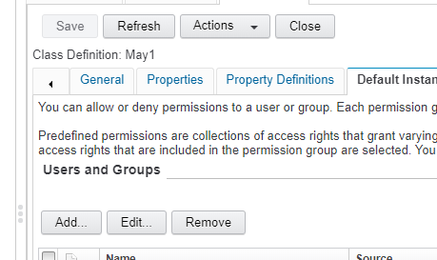
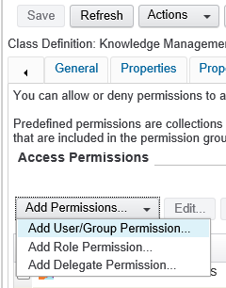
There are additional options are introduced from FileNet CPE release 5.5.3,
By using these feature we can delegate security of user or group to other.
We can create role permission and use the same template to assign the security to objects.
Security option are shown at the diagram attached.
Old & New

Slide 40
Security Inheritance architecture
• Security parents can be assigned to an object.
Inheritable ACEs are applied to the child object.
• Inherited security is computed only when needed for access.
ACLs for child objects do not change until the object is accessed
This diagram illustrates how inherited ACEs are applied to an object.
The object class definition has default instance security. When an object of that class is created, the default instance security of the class applies.
In addition to direct ACEs, the object can inherit permissions from a parent object. Inherited permissions are added to existing permissions. If you use Denials, direct permissions are evaluated first, then inherited permissions.

Slide 41
When is inherited security computed?
When security changes on a security parent, the objects that use that object as a security source are not immediately affected (that is, their ACLs do not change) for performance reasons. Inherited security is computed when the object is accessed, and only if Allow or Deny access is not applied directly. Waiting to check the inherited security until the last step in the process is much more efficient than updating all of the security children each time a security parent is updated.
Characteristics of inherited permissions
• Changing inheritable permissions on a security parent changes permissions on all versions of a security child.
• Inherited permissions are not directly modifiable.
You must modify the permissions on the security source object.
Inherited permissions are displayed as disabled in security interfaces.
• Deleting security parents
If you delete a security parent, the inherited permissions are removed from the child objects.
By design, inherited security cannot be modified on the child object. It can be modified only on the security source object.

Slide 42
Even the owner of a particular object is not able to change the inherited security for that object. You must have permission to change the security of the source to affect the inherited security. The diagram shows the ACL for a document that includes inherited permissions. The inherited permission is indicated by an arrow. The inherited permission does not include an X because it cannot be deleted. The permission cannot be edited, either. The reason that you cannot edit or delete inherited permissions on an object is that the inherited permission is not contained on the object. The inherited permission is a pointer to a permission on the parent object.

Slide 43
Methods for configuring security inheritance
• Two methods are available for setting up security inheritance in an object store:
The Security Folder method uses folders to set security on objects.
Inheriting objects have exactly one folder as the security parent.
Set the Security Folder property on the inheriting object.
The Security proxy method can use any class of object as a security parent.
Inheriting objects can have multiple security sources of this type.
Set the Security Proxy Type property on the inheriting object
.• An inheriting object can inherit whatever its security source inherited.
Two methods to set up security inheritance exist. The first method uses a folder as the security source.

Slide 44
• Security Folder method A Security Folder is a folder from which an object inherits security, but no requirement to file its security children in the folder exists. A folder inherits the security of its parent folder by default. Therefore, any security permissions that a folder inherits from its parent folder can be passed down to objects that have the child folder as their security parent. The behavior of how the security is inherited can be controlled by using the Inheritable depth property on the ACEs for the Security Folder. • Security Proxy Type method This method is a little more complex than the previous method. However, it allows for a more flexible security model to be used. Any class of object in an object store can be specified as the security parent, and an object can have more than one security parent if needed. This method can be combined with the previous method. This method of setting security parents can also be applied by a class definition. You can use this technique to automate the process of establishing security inheritance. The reference to the security parent object can be changed or deleted later if necessary.

Slide 45
Use a security folder
• Two methods for specifying a security folder exist:
Designate the folder as security parent by using Inherit security from folder.
Requires that the object is filed in the folder.
Designate a folder as security parent by using Security Folder.
Requires you to copy and paste object reference of parent object.
• Objects can have only one Security Folder at a time.
• The permissions on the folder must be configured as inheritable.
Inheritable depth for the ACEs must be set to include immediate children or all children.
• Security source assignment is done on each inheriting object.
• Deleting the folder removes the Security Folder relationship from the object.
• Moving the child object has no effect on the Security Folder relationship.
The two methods for setting the security folder property have equal outcomes, but have slightly different methods. The Inherit Security from Folder method does not require that you copy the object reference, but does require that the object is filed in that folder. You can select the folder from a menu. The second method (the Security Folder property method) does not require that the object is filed anywhere, but does require you to copy and paste an object reference.
Folder security inheritance can be automated by using a custom application. The Security Folder property value can be assigned to documents automatically.

Slide 46
Use an object as a security proxy
• Create a security parent object with inheritable permissions.
• Create a custom object-valued property (OVP)
Single-valued
Security Proxy Type is Inherited
• Add a custom property to the child class.
For Required class, select the exact class of the parent object.
• Assign the security parent in one of these ways:
Specify value of the OVP on the child object.
Specify default value of the OVP on the child object class.
• When the security parent object is deleted, the inherited security is removed from the object.
This method is more complex than using the Security Folder method, but it provides more flexibility. You can specify as many security parents as you need, and the security sources are not limited to being folders. For some business applications, the freedom to use other objects besides folders might allow for a more natural and simpler solution. This method can also be combined with the Security Folder method so that the final security on an object includes the inherited security from all sources.

Slide 47
Content Platform Engine V5.5 introduces new features and other enhancements to the security model.
Role-based access
You can now use Roles to configure access to objects. When you configure a role, you associate Role permissions with the objects that the role can access. A role can define different types of access for different objects. For example, an administrator role might grant "modify properties" and "create children" access for folder objects, but only "read" and "view content" access for document objects within folders. Security for an object includes any associated roles plus normal access permissions.
Roles are created as classes that exist in and apply to a specific object store. A role is defined by the following facts:
Access that is granted by the role- write, read, delete, and so on
Users or groups that belong to the role
When you create roles, you configure role permissions by specifying classes of objects and the types of access permissions to those objects.
Role classes
A default class called Roles provides two subclasses. To create a new role, you first must create a new subclass from either the Static Role subclass or the Dynamic Role subclass.
Static role - A static role contains users and groups that are assigned directly to the role. The behavior of a static role is similar to the way ACLs are assigned to an object.
Dynamic Role - A dynamic role uses external code to determine whether a user is a member of the role. This approach enables more dynamic role assignments that are based on application use cases

Slide 48
Sweep Management > Job Sweeps A job sweep runs one time to process instances of a target class. The Content Platform Engine includes job sweep subclasses with built-in actions. For example, you can create job sweep instances to move content between storage areas, or to update object retention. In the administration console, job sweeps are listed in the navigation pane under Sweep Management > Job Sweeps. A job sweep runs at the start time for which it is configured. If a start time is not set, then the sweep is eligible to start immediately. It will not start immediately if, for example, the sweep is disabled, or if time slots are set to times in the future. A job sweep includes counter properties that reflect the results of the job. ExaminedObjectCount - indicates the number of objects that the job sweep evaluated but did not necessarily process. ProcessedObjectCount - indicates the number of objects that met the criteria for processing. FailedObjectCount - indicates the number of objects that met the criteria for processing but failed to process. You can run a job sweep in normal or preview mode. In normal mode, a sweep performs an action on objects that meet the criteria for processing. If a processing error occurs on a swept object, the sweep generates a result record that includes a description of the failure. In preview mode, a sweep evaluates objects only; it does not perform an action on objects that meet the criteria for processing. There are two available preview modes. In "Preview only counters" mode, the job sweep only increments the examined-object and processed-object counters. In "Preview" mode, the job sweep also increments the counters, plus generates a preview result record for each object that the sweep would attempt to process if it were operating in normal mode. .

Slide 49
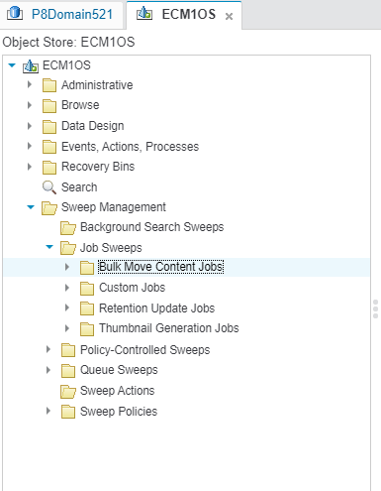
Sweep Management > Job Sweeps [..Continued] To remove a large number of result records at one time, you can you delete the job sweep itself. However, an attempt to delete a job sweep can fail if there are two many result records to be deleted within the global transaction timeout limit. In the event of such a failure, you can create a disposal policy that targets the sweep result class. A job sweep instance that has previously run cannot be re-executed. However, you can create a new instance of the same job sweep and run that instance. To quickly create a new instance with an identical configuration as the original instance, clone the original instance.

Slide 50
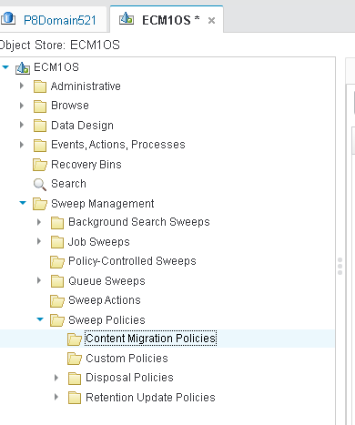
To create a Content Migration Policy : - by using Sweep Policies Select and copy a reference to the class of objects that are to be targeted by the sweep: A. In the domain navigation pane, select the object store. B. In the object store navigation pane, select the Data Design > Classes > specific class folder. Click the document or annotation class, go to Action, and select Copy Object Reference. In the object store navigation pane, select the Sweep Management > Sweep Policies > Content Migration Policies folder. On the Content Migration Policies tab, click New. Optional: Select the Enabled property to enable the sweep to run. Complete the wizard. In the wizard step where you specify the target class, click Paste Object.

Slide 51
Workflow System, Isolated Region & Connection Point
A workflow system is a collection of isolated regions. An isolated region contains the queues, rosters, and event logs that are necessary to create and process workflows. A workflow system uses the same database connection and schema as the object store with which it is associated. An object store can contain only one workflow system
An isolated region is a logical subdivision of the workflow database that contains the queues for the work items, event logs, rosters, and other configuration information. It also contains all transferred workflows and running work items. In a FileNet P8 system, all Workplace applications that use workflow functionality (Process Designer, Process Administrator, active workflows) uses a single isolated region.
To specify the process system and isolated region that is used by the Workplace applications, an administrator specifies a connection point in Workplace Site Preferences.
A system administrator uses Administration Console for Content Engine to define the isolated region and to assign a connection point name to that configuration.

Slide 52
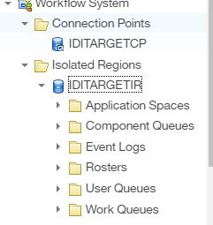
Workflow System
An isolated region is a logical subdivision of the workflow system that contains application spaces, queues, event logs, rosters, and other configuration information. It also contains all transferred workflows and running work items A workflow database can contain up to 1000 isolated regions, although a FileNet P8 system can access only one at a time. Within a workflow database, each isolated region is identified by a unique number ranging from 0 - 999. Isolated region 0 contains system data and is reserved for system software use. Users can define regions 1 – 999 An application space is way of organizing the resources for a custom application that uses a workflow. When you create an application space, you assign the security access for the application and create and assign roles to the users who process the activities in the application. You can also assign in-baskets to the roles that you assign to users. The in-baskets contain the work items that the users must process for the application

Slide 53
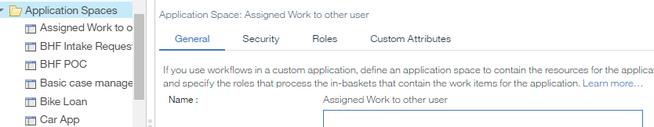
Workflow System [..Continued]
We can create in-baskets in the custom queues such as work queue or user queue. A roster is a database structure that holds all the active workflow elements (workflows and all work items, whatever their location), whereas a queue is a structure that only contains work items maintained there while they await processing. The Roster is a file containing a reference to all work items in a workflow. A Queue is a file containing a reference to a subset of the work items in a workflow. Queues are typically used to assign security to control access. Event logs contain a record of specific system or workflow-related events for each isolated region. This type of logging is useful for tracking workflow activity.

Slide 54
Process Configuration Console
Use Process Configuration Console to configure the components of a workflow system, such as the isolated regions, queues, rosters, event logs, and application spaces. Process Configuration Console will have three panes
Scope pane
The items in the scope pane (the navigation tree on the left) represent the items that you can manage by using Process Configuration Console: a workflow system with its queues, rosters, event logs, and application spaces.
Contents pane
When you select a node in the scope pane, the contents of your selection are displayed in the contents pane.
Pending changes pane
The lower right pane displays changes that are not committed to the workflow database. To save your changes, click Commit Changes on the Action menu.

Slide 55
Examples of business needs addressed with IBM FileNet Content Manager
1) Universities 2) Banking 3) Government agencies
Bank: Business need
•The Asset and Wealth Management division of a bank:
Over 150 content repositories and related systems across the globe
Each repository has its own taxonomy
Over 15 technologies used
Costs a substantial amount to operate annually
•The Sales and Marketing teams struggle to:
Find the correct version of a document.
Multiple versions are filed in multiple locations.
Prove which version of a document is provided to a client.
Prove that proper compliance was approved, relevant, or suitable.
The Asset and Wealth Management division of the bank is responsible for the creation, marketing, and selling of relevant products and solutions to clients (both individual and institutional). In a regulated industry, it is important for the bank to demonstrate that the products and solutions are appropriate for the clients and that the collateral provided to clients is suitable, relevant, and accurate. The bank has over 150 content repositories and related systems that are implemented locally across the globe. Each repository has a different taxonomy, uses more than 15 different technologies, and costs the bank a substantial amount of money to operate on an annual basis.

Slide 56
Examples of business needs addressed with IBM FileNet Content Manager [..continued]
The Sales and Marketing teams struggle to find the correct version of a document; multiple versions are filed in multiple locations. It is not always possible to prove which version of a document is provided to a client, or whether it is properly compliance approved, relevant, and suitable.
Solution
•Deploy IBM FileNet Content Manager to provide:
Scalable, secure, auditable repository
Used to upload compliance approved documentation
•Document upload performed by authorized users through IBM Content Navigator that uses:
External Data Services to dynamically create lists to choose from to populate document properties.
The lists are created from an external database, populated with accurate data.
Creates a common taxonomy
•Sales and Marketing use an IBM Content Navigator iPad app to search the repository for documentation.
•IBM Content Collector is used to integrate with an existing bank repository.
When a document is published in the existing repository, that document is ingested into the FileNet Content Manager repository.
Providing a gradual migration of the existing repository to the new centralized repository.

Slide 57
Examples of business needs addressed with IBM FileNet Content Manager [..continued]
Benefits
One place to look for product and solutions documentation.
Guarantee that the content is compliance approved before making it available to users.
Traceability of the use of the content.
Reduced operational costs through consolidation of platforms.
Automated management of the expiry of documents and reminders to upload new versions.
Configurable security to prevent access when products are withdrawn.

Slide 58
IBM Content Navigator
IBM FileNet Administration

Slide 59
IBM Content Navigator
IBM Content Navigator enhances your business processes, improves productivity and increases customer engagement by transforming how content is accessed, delivered and presented.
Content Navigator uses a powerful, easy-to-use interface that delivers trusted data quickly, no matter where the content is located or what type of data source.
Content Navigator enables secure, easy-to-integrate, custom applications development and delivers a consistent experience on any device.
Role-based redaction protects sensitive data while Teamspaces enable focused collaboration with powerful team and project site content capabilities.

Slide 60
Eleven powerful reasons you need IBM Content Navigator
Take your ECM solution to the next level
Integrate with powerful business applications
Create your own ECM apps
Empower your ECM users
Access and use trusted content fast
Leverage easy-to-use APIs
Protect sensitive data with role-based redaction
Empower teams and project sites with Teamspaces
Provide end users with an improved, modern user experience
Improve productivity by merging and splitting documents
Create and edit files using desktop application editors

Slide 61
Connecting and configuring - IBM Content Manager repositories & IBM Content Manager OnDemand repositories
To access the content in an IBM Content Manager repository / CMOD, you must first connect to at least one repository and configure it to use IBM Content Navigator as a web client. After you connect to and configure the repository, you must associate a desktop to enable users to access the content.
Connecting and configuring IBM FileNet Content Manager repositories
To access IBM FileNet® P8 repository content, you must first connect to at least one repository and configure it to use IBM Content Navigator. After you connect to and configure the repository, you must associate the repository with a desktop.
Connecting and configuring Content Management Interoperability Services (CMIS) repositories
To access the content in a repository that is enabled for Content Management Interoperability Services (CMIS), the repository must be defined and associated with at least one desktop.

Slide 62
Teamspaces
Teamspaces provide a focused view of the relevant documents, folders, and searches that a team needs to complete their tasks. You can use teamspaces to organize and share content, facilitate recurring work, and group specific items such as documents, folders, and searches that are needed to work on a project. If you plan to use teamspaces with your IBM® FileNet® P8system, you must determine who will be able to create and modify roles, templates, and teamspaces.
When you enable the teamspace feature on a repository from the administration tool, IBM Content Navigator runs the teamspace add-on on the repository. After you run the add-on, you can use the IBM Content Navigator administration tool to specify the users and groups that need to be able to create and view teamspace objects. For more information, see Security settings for teamspaces on IBM FileNet P8 repositories.
If you want to use the same ACL to manage access to teamspaces, documents, and folders, you can use the IBM Content Navigator administration tool to associate users with teamspace roles. When you use the IBM Content Navigator administration tool, the ClbTeamspaceACL is updated.
If you want to use separate ACLs to manage access to teamspaces, documents, and folders, you must use the IBM Content Manager system administration client to configure security for teamspaces. For more information on what security to configure, see Customizing the security settings outside of the IBM Content Navigator administration tool

Slide 63
Viewer maps
IBM Content Navigator works with several types of viewers. The IBM Content Navigator administration tool includes a default viewer map that specifies which viewer is used to open each file type.
A viewer map defines which MIME types are associated with each viewer that you want to use. For example, if you want to use the Applet viewer for a desktop, you associate it with the MIME type ANY. You then can add the back up viewers to use, such as Ajax or HTML, if the JRE failed. You can create multiple viewer maps if you want to use different viewers for different desktops, then go to any existing desktop and select a viewer map on that desktop.
The order in which you list viewer in your viewer map is important. The order determines which viewer is the fallback viewer if a mapping does not work.
You cannot edit the default viewer map. However, you can create a custom viewer map if you want to use different viewers or add file types to the mapping. You can associate only one viewer map with each desktop in your environment. If you create a viewer map, you must create a desktop to use that viewer map.
If you are creating a custom viewer, the viewer must be integrated as a plug-in before you can add it to the viewer map.
Specify the order for the viewers according to which viewer that you use the most. For viewers that implement fallback behavior, map a back-up viewer to the same repository and content types. In the event of fallback, the back-up viewer launches. For example, map a PDF viewer to open for Linux on System z®, with an HTML viewer configured as a backup. If the PDF viewer did not open, the HTML viewer would open. You can use multiple viewers that implement fallback to back up one another, in order of preference.

Slide 64
Role-based redactions
The redaction feature finds sensitive information in a document or image, and creates rectangular redaction annotations to cover the sensitive information. When the documents are subsequently viewed, the sensitive information is hidden from unauthorized users. You can edit the redactions in Datacap Navigator, and can export them to FileNet P8. The redactions are displayed as rectangles, which can be semi-transparent, and visible and editable in the Datacap Navigator client, but not in Desktop. Redactions can be exported to FileNet P8, and subsequently viewed in IBM® Content Navigator.
When a user opens, downloads, prints, or emails a document that contains sensitive data, redactions are burned into the document in real time. Role-based redactions are supported for TIFF and PDF files on the IBM® FileNet® P8 repositories on the IBM Daeja® ViewONE Virtual viewer.You must be a redaction administrator to configure role-based redactions.
Enabling Role-based redaction
Role-based redaction feature introduces a rectangular annotation that hides sensitive information on a document image. When a user views a document image, the redacted information is either hidden, or made visible, depending on the permission granted to the user. To use the Role-based redaction feature, you must configure and enable the feature.
Role-based redaction settings
You can use the Role-based redaction settings, where you can assign policy editors, redaction editors, specify redaction reasons, and so on. Redaction Reasons and Policies must be pre-defined in IBM Content Navigator, and imported into the Datacap application by using the Datacap Navigator administrator feature.
Creating and editing role-based redaction You can create and edit role-based redactions in Datacap Navigator, and export the redactions to FileNet P8 Any user in Datacap Navigator has permission to create and edit redactions that are imported or defined for that Datacap application.

Slide 65
Integration options available through IBM Content Navigator
• IBM FileNet Collaboration Services
• IBM Connections
• IBM CMIS for Enterprise Content Management
• Microsoft Office integration
• SharePoint integration
• IBM Docs
• IBM Quick File
• Sync services

Slide 66
Integration options available through IBM Content Navigator FileNet Collaboration Services IBM FileNet Collaboration Services connects a content repository to IBM Connections and enhances capabilities for collaboration and document management throughout an organization. IBM CMIS for Enterprise Content Management IBM Content Management Interoperability Services (CMIS) for Enterprise Content Management allows IBM FileNet Content Manager to integrate with repositories that conform to the OASIS Content Management Interoperability Services specification standard. Microsoft Office integration FileNet P8 integrates with Microsoft Office applications so that users can manage documents, email, and attachments that are within a FileNet P8 object store directly from the associated office application. SharePoint integration FileNet P8 and SharePoint technologies are complimentary solutions that, when used together, provide an environment where business users can easily collaborate on work-in-process documents and tasks, yet comply with content and compliance initiatives across the enterprise. SharePoint users can continue to use the SharePoint easy-to-use and familiar interfaces while IBM FileNet Content Manager provides a robust content, process, and compliance infrastructure that is transparent to users. With this approach, business users can use SharePoint Services sites and SharePoint Portal for most daily content, process, and compliance activities without having to learn new applications or perform additional content or compliance management tasks.

Slide 67
Integration options available through IBM Content Navigator [..Continued] IBM Docs The IBM Docs integration enables users to open documents that are stored in a FileNet Content Manager repository in IBM Docs for collaborative editing. IBM Quick File IBM Quick File provides business users with a security-rich, highly reliable way to exchange files inside and outside their organizations. Sync services Sync services provide an efficient way for users to work with files, avoiding the need to check out, check in, and download items that they work with regularly.

Slide 68
Edit Service in IBM Content Navigator
By default, the edit service includes support for Microsoft Office documents. However, you can configure the edit service to support other document types, such as PDF or HTML files.
The edit service streamlines the following processes for users:
Creating and adding new documents to the repository
When the edit service is enabled, a user can click New and select the type of file that they want to create. The file is added to the repository, checked out, and opened in the appropriate application on the user's workstation. Additionally, when the user saves their changes, the changes are checked into the repository.
Saving changes that are made in native desktop applications to the repository
When the edit service is enabled and a user clicks Edit > Edit with Desktop apps, the file is checked out and opened in the appropriate application on their workstation. Additionally, when the user saves their changes, the changes are checked into the repository.

Slide 69
Daeja ViewONE
IBM® Daeja™ ViewONE provides web-based image viewers that extend your web browser. You can use these viewers to view, annotate, zoom, magnify, scroll, pan, rotate, and print your images and image documents quickly and easily.
In environments that support Java™, you can use the viewer that is provided by IBM Daeja ViewONE Professional. For environments that do not support Java, you can use the HTML5-based viewer that is provided by IBM Daeja ViewONE Virtual.
IBM Daeja ViewONE Professional is an extensible, web-based document and image viewer that provides access to content across platforms and multiple languages.
IBM Daeja ViewONE Virtual is a server-based document and image viewer that provides a lightweight HTML and JavaScript front end for users of mobile devices or desktops. Most processing takes place on the server, which makes the viewer ideal for use where a client Java environment is not permitted or supported. Therefore, you can use IBM Daeja ViewONE Virtual to provide a lightweight front end for users of mobile devices or desktops where a JRE is not supported.
Differences between stored search and search template
Stored search is complete search.
Search templates are for a partially completed search where users are promoted for search criteria.
Stored search execute automatically when opened.
Search template allows user to fill the search criteria’s and perform search.

Slide 70
IBM Content Navigator Admin Desktop User Interface
The desktop is provided for administering the web client. It uses a tabbed interface to allow easy navigation.
The Admin desktop access–
The URL for the Admin desktop: http://<server>/navigator/?desktop=<ID>
ID → admin – Only specified users can access the Admin desktop.
The screen capture shows the tabs in Administration View of IBM Content Navigator.

Slide 71
IBM Content Navigator Web Client Components
• Web client components
–A set of repositories
–A Viewer Map
–A layout
–A set of menus
–A set of workflows
• Common components
Apply to all of the desktops:
–Error logging settings
–Labels
–Icon mappings
–Plug-ins
The screen capture shows the IBM Content Navigator web client components.

Slide 72
IBM Content Navigator Administration Tasks
Define desktops for Business Users.
Create connections to repositories.
Configure Sync Services.
Set Repository specific configurations.
Add Administrator users.
Customize desktop
– Customize banner and login page.
– Create custom menus.
– Configure plug-ins that extend the Content Navigator capability.
– Specify which Viewer is used to show each file type.
– Customize the text labels and icons that are shown in the interface.

Slide 73
Configure IBM Content Navigator desktops
A desktop includes the following default features:–
Favorites, Browse, and Search
A list of repositories that are available for a desktop.
Other information for a desktop–
Viewer Map, Layout, Menus, and toolbars, Workflows, Teamspace.
Configure properties for a desktop–Name and ID–Repository Authentication–Selected repositories–Selected features– Application name
An IBM Content Navigator desktop is one instance of the IBM Content Navigator web application user interface within the Content Navigator deployment.
You can create several desktops

Slide 74
Desktop Actions
Create a desktop
Edit an existing desktop.
Copy an existing desktop into a new desktop and edit the new one.
Delete a desktop that you no longer need.
Export a desktop for a different instance of Content Navigator.
Import a desktop from a different instance of Content Navigator.
Control user access to desktops
The Administrator specifies a default repository for each desktop.
Authentication of users occurs in the default repository for the desktop.
Each desktop is accessed through its own web address.
For each desktop, you can enable or disable the features for all users of that desktop.
Teamspace and In-baskets can control access by roles.
Authorization: Repository security controls the access to specific content within the desktop.

Slide 75
Export desktops •The following items are automatically exported with a desktop: –Viewer Maps –Menus –Mobile application features •You can include the following configuration components to the export –List of users and groups who are authorized to use the desktop –Repositories that are associated with the desktop –Plug-ins that are associated with the desktop

Slide 76
If you have multiple instances of the IBM Content Navigator web client in your environment, you can export your desktops to a file. You can then import the desktops to another instance of IBM Content Navigator.
Important:
The IBM Content Navigator instances must be at the same version level.
Procedure to export a desktop
•In the IBM Content Navigator web client, select the desktop and click Export.
•In the Export Desktop window, enter a name for the export file.
▪Select the Include users and groups option.
▪Select the repositories, plug-ins, and themes that you want to include in your export.
▪Click Export.

Slide 77
IBM Content Navigator Plug-ins
•Use custom plug-ins to customize the IBM Content Navigator web client.
–Extend the functionality –Change the default behavior
•The IBM Content Navigator software package includes several samples.
–Use the samples as a starting point to create custom plug-ins as required.
You can extend the default functionality and change the behavior of the IBM Content Navigator web client with the use of plug-ins.
▪For example, you can create a plug-in to add a menu action or to validate data entry.
▪The IBM Content Navigator software package includes several samples that you can customize as required.
▪In this lesson, you register and configure the sample plug-in for the IBM Content Navigator web client application.
Custom Plug-ins
•You can create plug-ins for the following uses:
–New features and layouts
–New menu items and toolbars
–Viewers, widgets, and services
•IBM Content Navigator includes the following plug-in samples.
–Sample External data services plug-in (EDS)
–Sample Plug-in (includes sample feature, layout, viewers, and actions)
Directory location for the samples
▪Microsoft Windows: C:\Program Files (x86)\IBM\ECMClient\samples
▪Linux or AIX: /opt/IBM/ECMClient/samples

Slide 78
Register a Plug-in
The screen capture shows the new plug-in page in IBM Content Navigator.
Steps to register a plug-in
1.In the "Plug-ins" page of the Content Navigator Administration tool,
click "New Plug-in" , or Edit for the existing plug-in.
2.Load the plug-in file from the directory where it is located.
▪If the JAR file is in the local file system, enter the path.
▪If the JAR file is in a remote server, enter the URL for the plug-in.
3.You can also load a compiled class file from your local system.
▪Enter the plug-in file path (without the package name) in the Class file path field.
▪Enter the plug-in class name with the package name in the Class name field.
4.Configure the parameters.
▪The developer for the plug-in can optionally include input fields for entering
configuration information.
▪Example : URL for the web application, server name.
▪Enter the required values.
5.Save the settings.

Slide 79
IBM Content search services
IBM FileNet Administration

Slide 80
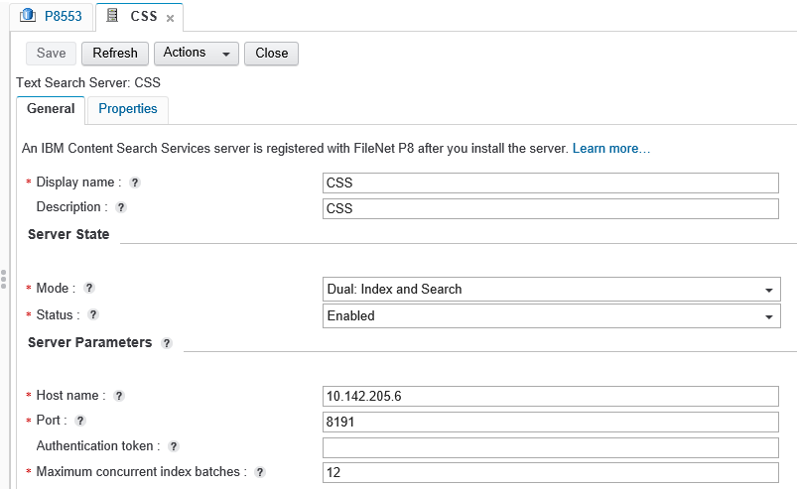
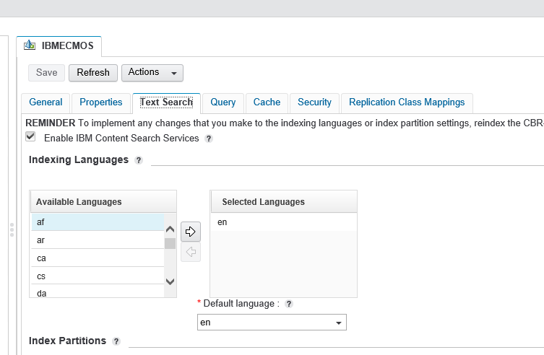
Content Search services IBM® Content Search Services consists of index and search servers that are created and registered at the FileNet® P8 domain level. The Content Platform Engine’s text search dispatcher passes index and search requests to Content Search Services servers. The servers in a domain are available to all of the object stores in the domain. For multiple sites in a domain, servers in a site can access only the object stores that belong to the same site. The individual servers in a domain can be enabled or disabled Content Search Services supports multiple languages. When configuring an object store for indexing, you must select the languages of the content that will be indexed for that object store. An index belongs to an index area, and an index area is dedicated to a single object store. An index area is a file system directory that contains the information necessary to perform full-text indexing that is updated and queried by Content Search Services.

Slide 81
Content Search services Index servers An index file can be accessed by only one index server at a time. Content Platform Engine assigns indexes to the available index servers so that the work load is roughly the same for all servers. If an index area belongs to an affinity group, the indexes in that area are assigned to servers that belong to the same group. Search servers When a CBR query is submitted, Content Platform Engine selects a search server to run the full-text search for the query. (A full-text search expression is specified as part of the CONTAINS function call in the CBR query.) The default search server selected is the dual-mode server that most recently updated the index that is relevant for the full-text search To configure CSS on FileNet domain we need to register CSS by providing the authentication token as shown in the diagram above. Then at object store enable text search services for desired language as shown above. Then enable CBR on the document class.

Slide 82
Administration tools & components
IBM FileNet Administration

Slide 83
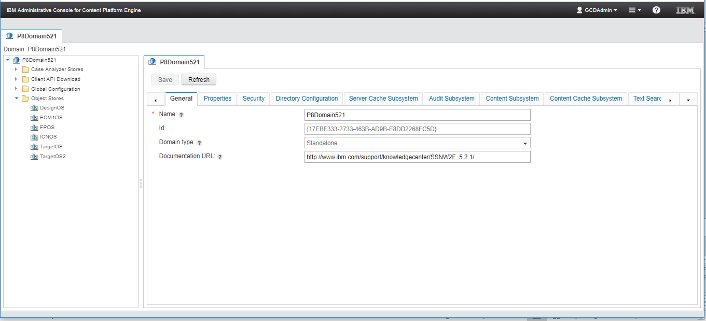
ACCE URL
http://<HOSTNAME>:<port>/acce
Example : http://10.242.25.193:9080/acce
ACCE is the UI for the FileNet Administrators to configure / manage the system.
This web application will work only when all the support components ( Application server , GCD database , Directory Servers ) are up and running.

Slide 84
Administration Console for Content Platform Engine
Web application used to administer FileNet P8 domains.
Global Configuration data (GCD)
Object stores
Other objects

Slide 85
The Administration Console for Content Platform Engine, often referred to as ACCE (pronounced ace), is a web-based application used to administer FileNet P8 domains and their resources.
•Global Configuration data (GCD)
•Object stores
•Other objects
ACCE is an application that runs on a Java EE application server. To start ACCE, you use a web browser to go to the URL shown on the screen capture in the blue callout. The Welcome screen displays, as shown in the screen capture on the left. You log in with an account with read access to the FileNet P8 domain. The FileNet P8 Domain navigation is displayed, on the right. The screen capture shows six object stores under the object stores node.
ACCE was introduced in IBM FileNet Content Manager 5.2. Previous releases used FileNet Enterprise Manager (FEM) to do the administration. FileNet Enterprise Manager was removed starting with IBM FileNet Content Manager 5.2.1. If an older release of IBM FileNet Content Manager is upgraded, FEM is still there. New installations do not include FEM.

Slide 86
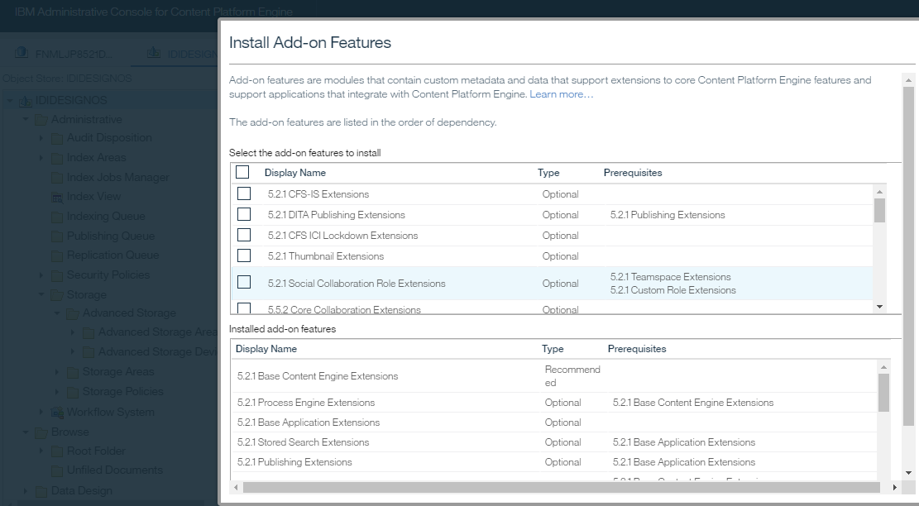
Installing an add-on to a object store
Add-on features are modules containing custom metadata (classes and properties) and data (objects such as folders, custom objects, and so on) that support extensions to core Content Platform Engine features, as well as support applications that integrate with Content Platform Engine.
You can create an add-on feature or modify an existing add-on feature. Modifying an add-on feature does not affect object stores that already use the add-on feature. You can delete add-on features that have not yet been installed; you cannot delete an add-on feature if it is currently installed in an object store.
To install an add-on feature to an object store:
Access the object store in the administration console:
In the domain navigation pane, click the object store where you want to install the add-on feature.
In the object store navigation pane, click the name of the object store (the top-level item).
From the Actions menu in the object store tab , click Install Add-On Features.
Select the add-on feature that you want to install and click OK.

Slide 87
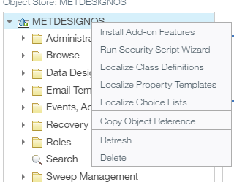
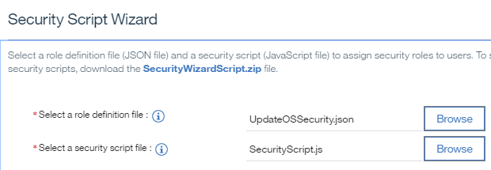
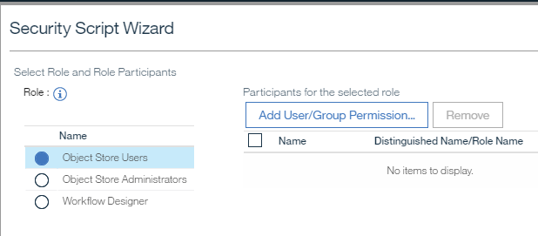
Providing Administrator access to an object store
A directory service account that can administer an object store by having Full Control access to it. You can also grant Full Control to an object store to group accounts, thereby making all members of the group object store administrators.
There are two approach we can follow,
Adding user to object store administrator group to get the access.
By running Security script wizard against the object store.
Execution of script has shown in the screen shot attached at
the right.
Use of the script WizUpdateOSSecurity.vbs installed by the Content Platform Engine installation program. This script updates an existing object store's security with users and groups as if they had been added when the object store was originally created.

Slide 88
FileNet Deployment Manager
Objects in an object store contain data that is specific to the environment in which the object store resides. This environment-specific data includes the object store IDs and the access control lists for the objects. To import objects into a different environment, you must first update the environment-specific data in those objects. FileNet® Deployment Manager helps you with this task.
Environment
You use FileNet Deployment Manager first to create an environment definition for each of your deployment environments. As part of this definition, you provide the configuration information that the tool needs to connect to the environment.
Half-map
You then use FileNet Deployment Manager to retrieve information that identifies the object stores, security principals, and workflow systems services in that environment. The tool places this information in files called half maps, which are stored along with the configuration information as part of the environment definition.
Environment pair
To define a specific deployment, you configure a source-destination pair that identifies the source and destination environments for the deployment. An environment definition, which can be used in multiple source-destination pairs, might represent a source environment in one pair and a destination environment in another pair. For example, if the deployment sequence is from a development environment to a test environment to a production environment, you need two source-destination pairs. In one pair, the test environment acts as the destination environment. In the other pair, the test environment acts as the source environment.

Slide 89
FileNet Deployment Manager
As part of configuring the source-destination pair, you use FileNet Deployment Manager to map the environment-specific information for the deployment. This mapping process combines the information from the four half maps for each environment to create four data maps. For each object store in the source environment, the object store data map identifies the corresponding object store in the destination environment. For each user or group in the source environment, the security principal data map identifies the user and group in the destination environment that is to be assigned the access privileges of that principal. For each workflow systems service in the source environment, the service data map identifies the corresponding service in the destination environment.
FileNet Deployment Manager creates a log file in the directory in which the application is installed. To avoid errors, ensure that you have write access to this directory before you use FileNet Deployment Manager.
FileNet Deployment Manager does not support deployment trees that were created by using versions that are older than version 4.5.1.
FileNet Deployment Manager runs with FIPS (Federal Information Processing Standards) 140-ready mode enabled the first time that you start it. When you run in this mode, the application does not save passwords to disk; it retains unclear passwords in memory. You can disable this mode to allow passwords to be saved to disk in encrypted format.
You cannot use FileNet Deployment Manager to import or export metadata between different versions of Content Platform Engine.

Slide 90
FileNet Configuration Manager
•IBM FileNet Configuration Manager is a tool that automates FileNet Content Manager configuration tasks.
•Used for configuring FileNet P8 settings:
Data sources that are required for object stores.
JDBC connections
DAP connections
Bootstrap properties
•You can use Configuration Manager to generate one or more unique Content Platform Engine configuration profiles.
A profile is a collection of information that is required to configure and deploy new or upgraded Content Platform Engine instances.
Example: CEConfig.cfgp
You can use profiles as templates for configuration.
The information for a profile is collected in XML files in the form of properties and values that describe the associated configuration and deployment tasks. You must provide values for the profile properties that are specific to each configuration at your site, such as the application server name. The XML files are stored in a directory that is unique to a profile. Because the profile name is used for both the directory name and the configuration file name, you must provide a profile name that is a valid directory name for your operating system. By default, the profiles are stored in the ce_install_path/tools/configure/profiles directory, where ce_install_path is the location where Content Platform Engine is installed.

Slide 91
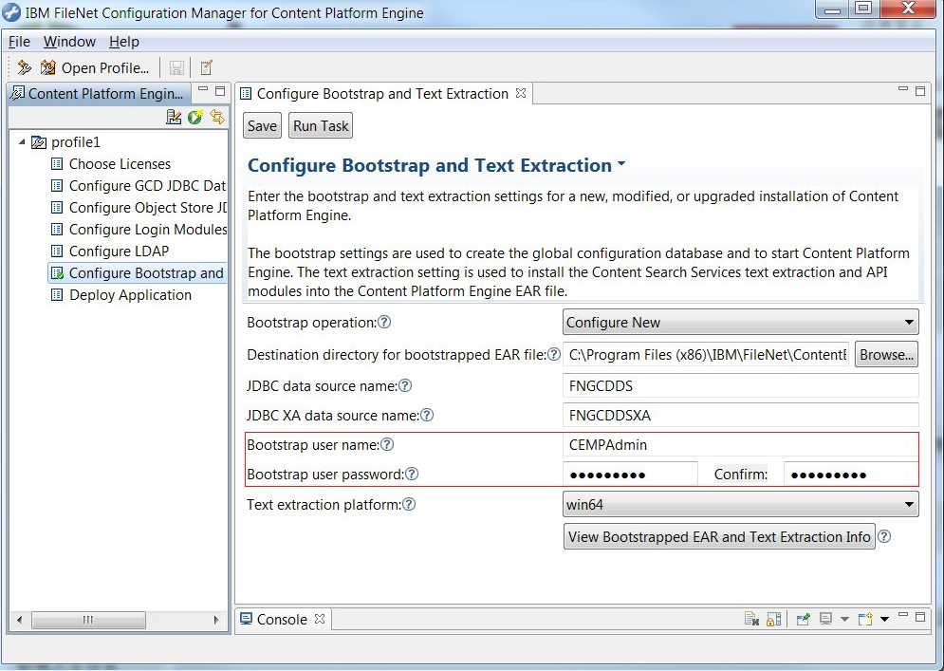
Configuration Manager Interface

Slide 92
Content Consistency Checker
You can use Content Consistency Checker to perform the following checks.
Validate storage areas
Check the consistency between the metadata in the object store database and the files in the selected storage areas. Inconsistencies are listed in a validation report.
View validation reports
Review the inconsistencies that were reported when the selected storage areas were validated.
Update storage area statistics
To perform a consistency check, you must first select one or more storage areas. Content Consistency Checker displays the storage areas associated with the current domain.
For each storage area, the result of the last storage area validation is displayed. The data displayed in the Date Last Checked and Result columns is stored on the computer where the Content Consistency Checker validation was last run. If the validation was last run on another workstation, the current workstation does not have information about that run and indicates that the information is unknown. A result of "Interrupted" indicates that the validation was stopped before completion.

Slide 93
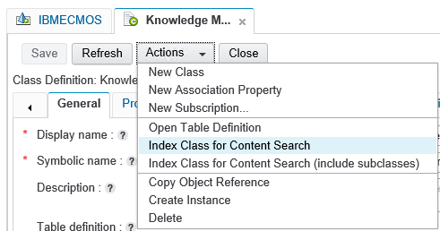
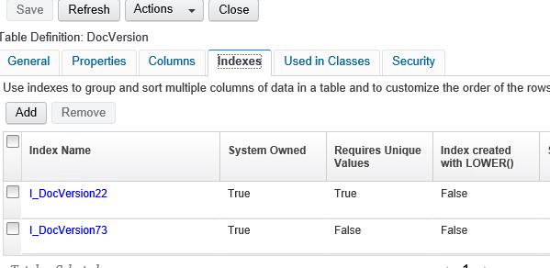
Indexes Indexes are used to quickly locate data without having to search every row in a database table every time a database table is accessed. Indexes will increase performance of IBM FileNet while searching for document. Creation of indexes for property using ACCE is shown at the right

Slide 94
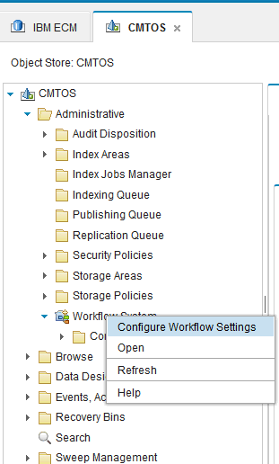
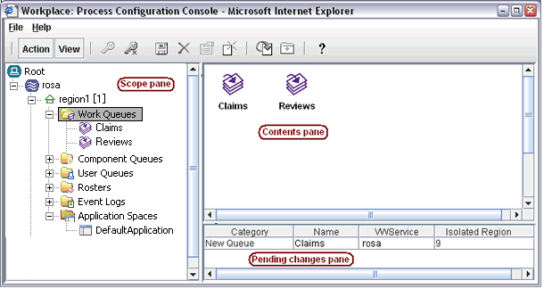
How to Open PCC
Log into Administration Console for the Content Platform Engine (ACCE).
Under the domain node, expand the Object Stores node.
Click on the node for the object store that is associated with the Workflow System you want to work with in the
Process Configuration Console or the Process Administrator. The navigation tab for the object store will open.
In the navigation tree pane on the left hand side, expand Administrative.
To open the Process Configuration Console: Right-click Workflow System and choose Configure Workflow Settings.

Slide 95
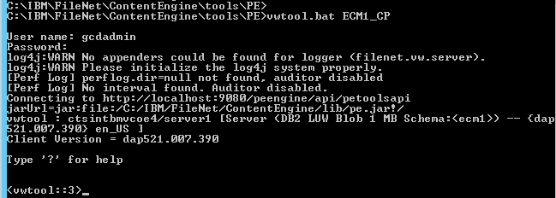
VWTOOL The vwtool utility is a command line-driven system support and administration program you can use to analyze and modify various components of a workflow system. The vwtool utility can run on any client of a Content Platform Engine server. In a farmed workflow system where multiple servers can host client requests for load balancing, a vwtool client request can be directed to any server in the farm. To support vwtool commands that manipulate the memory state of a particular server in a server farm, these vwtool commands display information for all servers or prompt for a server name. Because request and response actions are serial across a network instead of within a process, response speed and timeouts are affected. In a workflow system, vwtool accesses an isolated region at a time. Although most of the vwtool information that is returned is specific for an isolated region, some vwtool commands return local server-specific information.

Slide 96
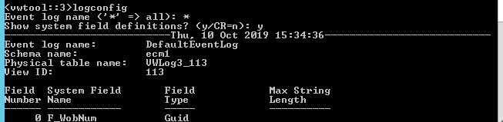
VWTOOL VWTOOL will be located in <CPE installed path>/Tools/PE/ To start VW tool we can use below for: vwtool connection_point [-v] [-Y user_name + password] Below are some command usage mentioned, appspace List the application space class name, description, and security. asyncrpc Monitors asynchronous, long-running workflow tasks. cbe Control generation of IBM Common Base Event (CBE) monitoring data for the current region. config View configuration information for the isolated region. convert Convert a value from or to a time, error, or log event value. count Count the number of work items in a specific queue or roster. dump Display class definitions, instruction sheets, CDL files, workspaces, work items, object IDs, and binary large objects (BLOBs) saved in the workflow database. echo Echo a text message to the screen and log it in the system log. emptyqueue Delete all work items from a specified queue. environment Display or reconcile user or system environment field values. flushusercache Flush the environmental records that are cached in server memory. hardcopy Save your vwtool session output to a specified text file. help List all of the commands available in vwtool.

Slide 97
Troubleshooting, health check , Logging & tracing
IBM FileNet Administration

Slide 98
FileNet System URL’s
Content Platform Engine URL
http://<HOSTNAME>:<port>/FileNet/Engine
CPE Health Page URL
http://<HOSTNAME>:<port>/P8CE/Health
CPE Automatic Upgrade Status
http://< HOSTNAME>:<port>/FileNet/AutomaticUpgradeStatus
ACCE URL
http://<HOSTNAME>:<port>/acce
Content Navigator Admin URL
http://<HOSTNAME>:<port>/navigator/?desktop=admin

Slide 99
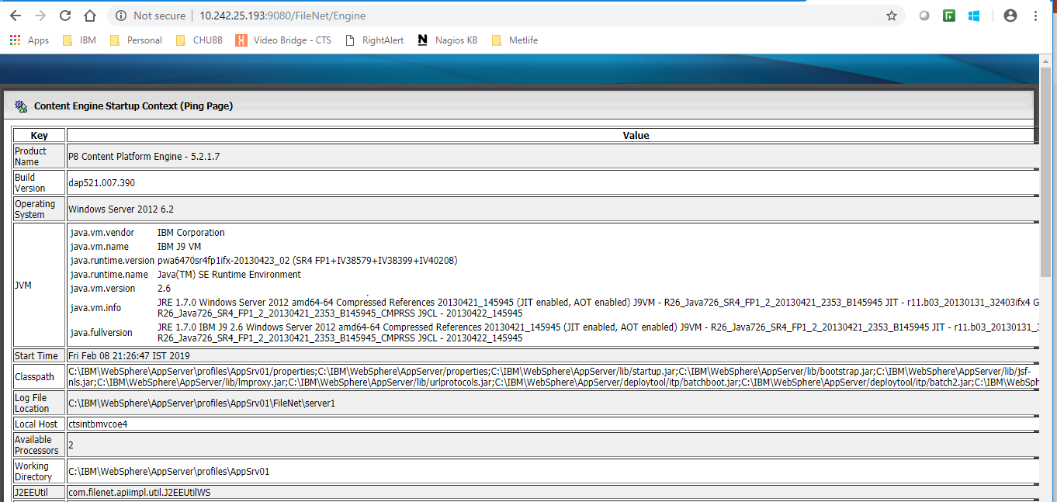
Content Platform Engine URL
http://<HOSTNAME>:<port>/FileNet/Engine
Example : http://ecmlab:9080/FileNet/Engine
This URL also called as CPE Ping page. The response of this page ensures that the FileNet Engine web application is up and running.
This page shows you the current CPE version running along with the number of processors on the server
This also gives you information of the application server working directory for the CPE web application

Slide 100
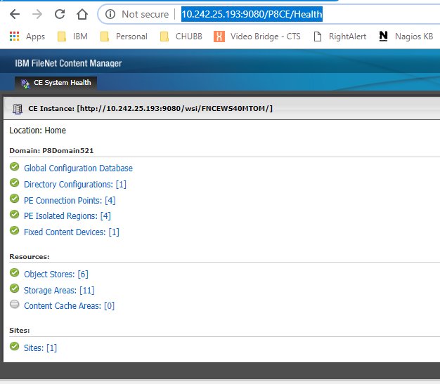
CPE Health Page URL
http://<HOSTNAME>:<port>/P8CE/Health
Example : http://10.242.25.193:9080/P8CE/Health
This page shows you the status of all the domain components, resources & Sites
The Green status indicates the component / resource is available and the Red status indicates the component is not available / inaccessible.

Slide 101
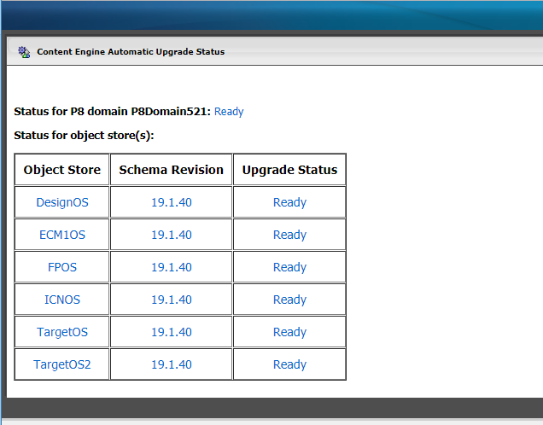
CPE Automatic Upgrade Status
http://<HOSTNAME>:<port>/FileNet/AutomaticUpgradeStatus
Example :
http://10.242.25.193:9080/FileNet/AutomaticUpgradeStatus
This page shows you the upgrade status of FileNet Domain & all the Object Stores

Slide 102
CPE Automatic Upgrade Status [..Continued]
This page shows you the different upgrade status of FileNet Domain & all the Object Stores during automatic upgrade process.
Domain and object store availability | Status | Description
The FileNet P8domain or object store is not available for use. | Not Available | The Content Engine server cannot determine the status of the object store. The server is still starting the Content Engine application and cannot access the object store to determine its status, or the object store cache was not loaded. Wait a while for the server to finish starting, then refresh the AutomaticUpgradeStatus page to update the status.
The FileNet P8domain or object store is not available for use. | In Progress | Exclusive upgrade work is currently in progress on the FileNet P8 domain or object store. The Schema Revision column in the Status for the object stores section displays the upgrade phase that was completed.
The object store is available for use. | Asynchronous Upgrade In Progress | Exclusive upgrade work was completed for the object store. Additional asynchronous upgrade work that requires long-running tasks (due to the large number of documents or custom objects in the object store) to complete is in progress. At least one server in a site associated with each object store must have asynchronous processing enabled for this phase to complete.
The FileNet P8domain or object store is available for use. | Completed | This FileNet P8 domain or object store was upgraded since the Content Engineserver was started. Click Completed to view the detailed status for the upgrade process.
The FileNet P8domain or object store is available for use. | Ready | The FileNet P8 domain or object store is either a new entity, or the upgrade process finished before this Content Engine server was started.

Slide 103
Logging and Tracing
CPE Application Server logs
CPE Server Trace logs
CPE Client Trace logs

Slide 104
CPE Application Server logs
You can find the CPE application server logs in different location depends on the application server you are using for CPE. Here we are going to see the path of the CPE Application server logs when we use IBM WebSphere Application Server.
The default path of the CPE application server log is : <WAS Home>/profiles/<profile name>/logs/<server name>/
Example : /opt/IBM/WebSphere/AppServer/profiles/AppSrv01/logs/server1/SystemOut.log
/opt/IBM/WebSphere/AppServer/profiles/AppSrv01/logs/server1/SystemErr.log
In the SystemOut.log you will find the application start / stop messages , Data source connection messages, etc.
All the CPE related errors also will be written to the SystemOut.log by default. Below are some of the common CPE related errors:
E_OBJECT_NOT_FOUND
E_ACCESS_DENIED
E_BAD_VALUE
E_FAILED_TO_GET_DATASOURCE

Slide 105
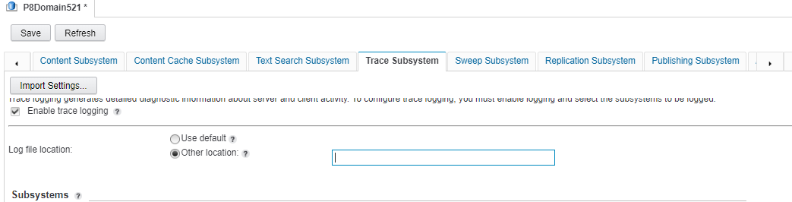
CPE Server Trace logs [ P8 Trace logs]
In most of the cases , IBM support will ask for P8 Trace logs when we ask for any support for FileNet Content Manager issues.
The default path of the P8 Trace & Error log will be as below
<WAS Home> /profiles/<profile name>/FileNet/server1/logs/
While enabling the detailed trace logs, an administrator will have an option to change the path of the P8 Trace logs.

Slide 106
CPE Server Trace logs [ P8 Trace logs] [..Continued]
You can enable the Trace logs at different level like Domain , Site , Server based on the different scenario.
As part of CPE Trace logs an administrator can collect the details of the various sub-systems details in FileNet Content Manager at different level of information like Detail, Moderate , Summary & Timer.
Steps to enable the Trace logging:
Login into ACCE console with administrator access
Navigate to Trace Sub System tab at the domain level
Check the Enable Trace logging option
If required choose the Other Location and provide the new path for the Trace logs
Under Sub systems, choose the level of details you need to collect
Click on Save button on top.

Slide 107
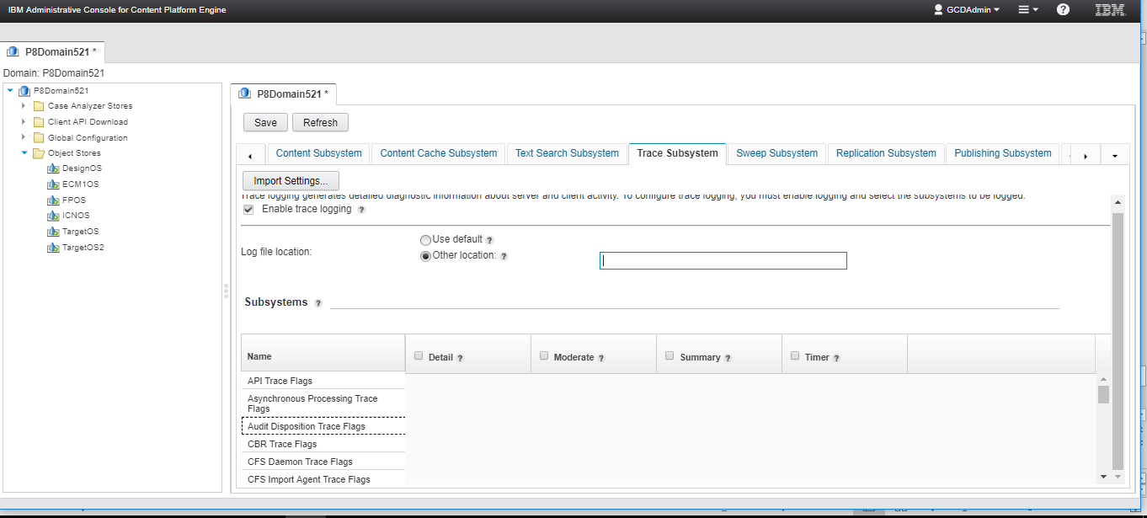
CPE Server Trace logs [ P8 Trace logs] [..Continued]

Slide 108
CPE Client logs
In order to enable the CPE Client logs, you need to place the log4j.properties in the application path and restart the application.
By default CE's log4j.properties is located <install path>\FileNet\AE\CE_API\config\samples\log4j.properties.client
In some cases where the application may have it’s own log4j.properties. In such cases, you need to copy the content of CPE log4j.properties to the application’s log4j.properties.

Slide 109
Thank you

Slide 110
Some additional infomation

Slide 111
Security Policy
A security policy serves as a collection of security templates, each of which contains a predefined list of permissions, or Access Control Entries, that can be configured to apply to a document, custom object, or folder.
Security policies allow system administrators to apply access control to large numbers of documents without directly editing the ACL on each document.
Security policies, in conjunction with versioning states, allow a system administrator to configure the system to automatically modify ACLs on documents when their versioning state changes. For example, the administrator can configure the system to automatically grant access to a document to a wide audience when it is released.
Security policies can be configured not to preserve direct security. Therefore, if a policy is configured to ignore direct security, a user can be granted access to an object even if that user is otherwise denied access by direct security.
If a user is allowed access to a document as an individual user but belongs to a group that is denied access, then that user does not have access to the object.
When objects are added, the default instance security on the class becomes Direct security on the new object.
Both Direct and Default security can be modified on the object. After either type of security is modified, the source is listed as Direct.
Security markings provide an extra, optional layer of security that is primarily designed for the records management marketplace, but the feature can also be used by non-records management applications.
Implicit denial
On systems that use Allows only, access is granted and where not granted is implicitly denied.
Using Allows exclusively simplifies the security system. Unless explicit denials are required for some reason, it is best to avoid them.

Slide 112
Marking Sets
Markings allow access to objects to be controlled based on specific property values.
When a marking is applied to an object, the resulting access permissions for the object are a combination of the settings of its original access permissions and the settings of the marking's Constraint Mask for each marking that is applied to it. The result of this combination is the effective security mask.
In general terms the way the markings works is:
A marking set is defined, containing several possible values called markings.
Each marking value contains a set of access permissions which define who can assign that specific value to an object property, who can modify or remove that specific value, and, once it is assigned, who will have access to the object it is assigned to.
The marking set is assigned to a property definition on a class such that the value of that property on instances of the class must be one of the markings defined by the marking set.
Values can only be assigned by users authorized by the associated marking and access to the object is restricted based on the marking once it is applied.
Markings do not replace conventional access permissions on an object, but rather are co-equal with them in determining access rights. In other words, if an object has one or more markings applied to it in addition to one or more permissions in its permissions collection (ACL), then access to that object is only granted if it is granted by the permissions and by the markings.

Slide 113
Another way to think about how this works is:
A user or process tries to access an object.
First, Content Engineer resolves the object's ACL to determine who can access the object and what those users can do.
Then it computes the markings applied to the object to see which users to stop (defined by the marking's Security list) and what they should be stopped from doing (defined by the marking's constraint mask).
You can have multiple properties assigned to a single class with marking sets associated, and they will all be used to determine the final access to the object. The collection of all markings being actually applied to a particular object is displayed by Enterprise Manager as the object's "active markings".
"Active markings" is the term Enterprise Manager uses in its security editor on its Active Markings/Owner button. You will see this button text on object instances whether or not there are actually active markings applied to the object. This button will just say "Owner" for those objects that cannot have markings applied, which include all class definitions.
Modifications to markings or marking sets are subject to the Marking Set Cache Entry TTL setting which affects how often the marking set cache is updated on the server and the current Enterprise Manager machine.
However, the marking set cache is updated whenever any change or addition is made to markings or marking sets. Therefore, the cache is most likely up-to-date by the time the Marking Sets TTL forces a refresh of the cache.
Markings and marking sets are persisted in the FileNet P8 domain resource, the GCD. This gives them IBM® FileNet® P8 domain-wide scope, that is, they are available and have the same meaning across all object stores in a IBM FileNet P8domain served by a common GCD. The marking-enabled property templates and the actual properties based on these templates are, however, specific to the object store in which the property template was created.

